Slide 1
UMTAPO
Free the mind Free the Land

Slide 2
Vision & Mission
Vision
A society that will be characterised by political, social and economic justice, and values that are consistent with the spirit of Ubuntu, an African philosophy
Mission
To engage in popular education and social activism promoting ubuntu, self-reliance, anti-racism and anti-sexism, critical thinking, and ethical leadership.

Slide 3
The Umtapo Model Building from a Solid Foundation

Slide 4
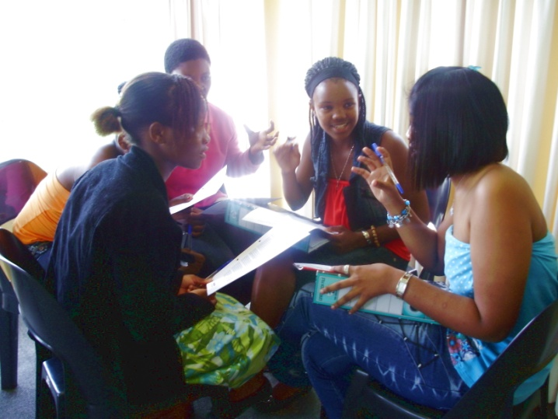
UMTAPO in Schools
Involves:
Training Courses for Learners, Educators and Department of Education officials
Leadership Camps for learners in primary and secondary schools
Campaign against sexual abuse in schools
Anti-Bullying Campaign in Schools

Slide 5
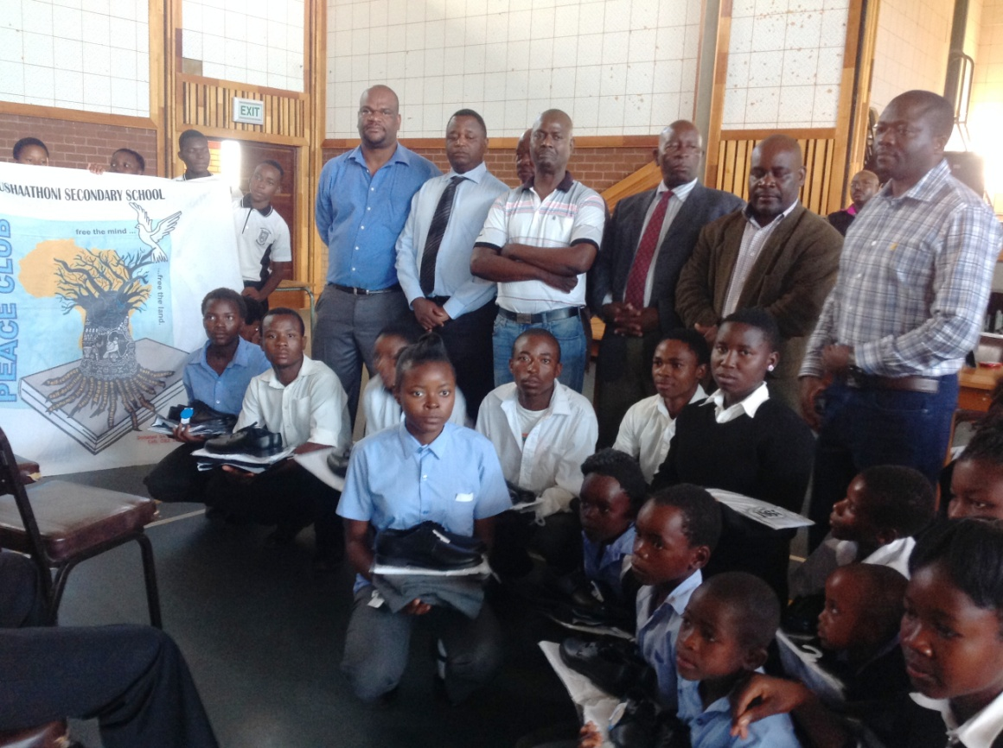
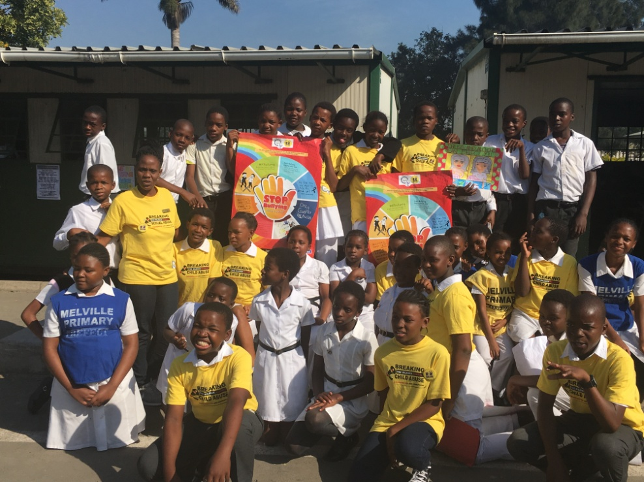
UMTAPO in Schools
Establishment of Peace Clubs in high schools and primary schools

Slide 6
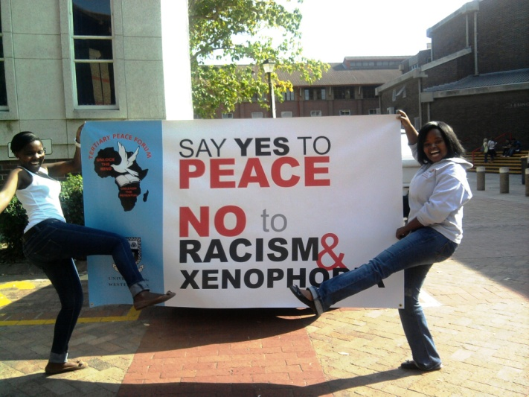
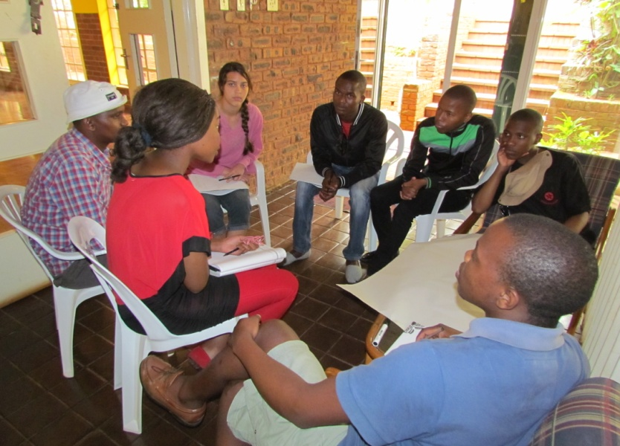
UMTAPO at universities
Setting up UMTAPO Student Movement branches
Training courses in Democracy, Human Rights, and Anti-Corruption
Campaigning for anti-racism, anti-sexism, ant-corruption and revival of Ubuntu

Slide 7
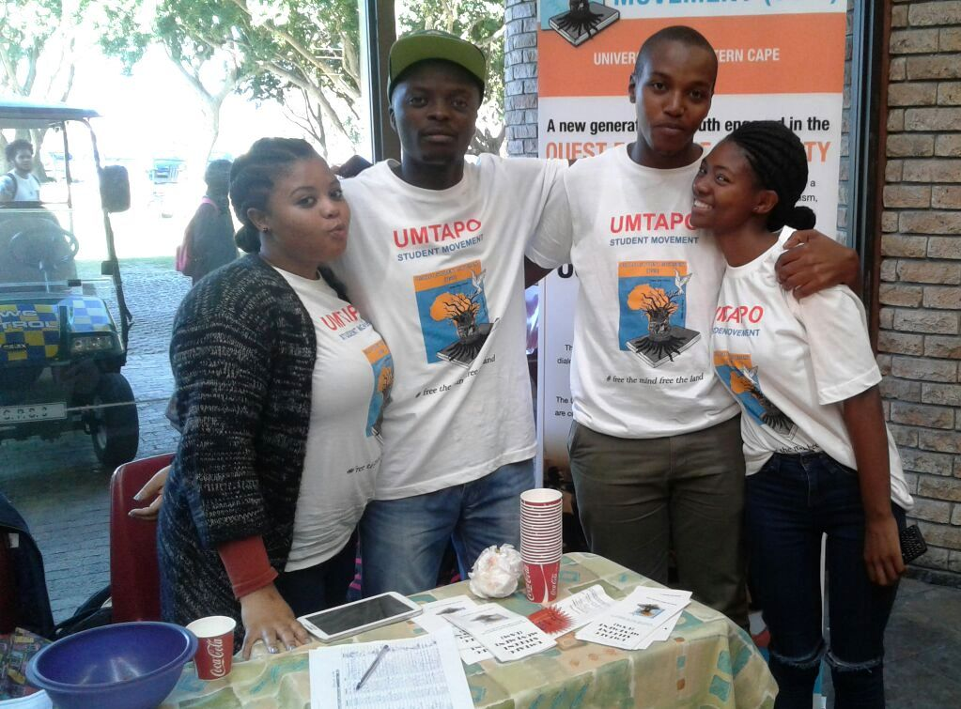
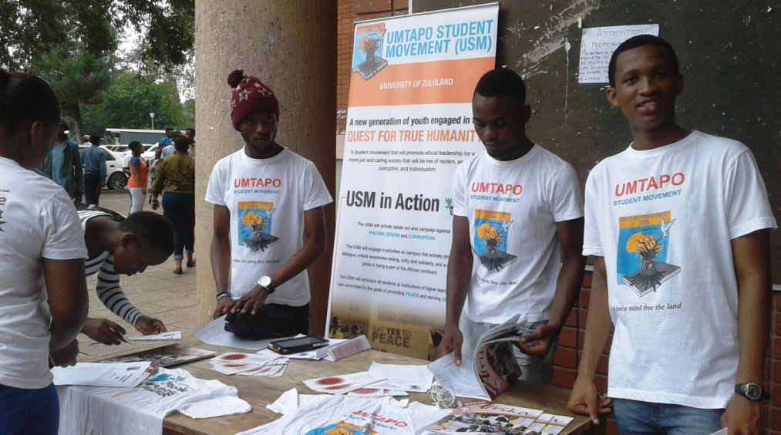
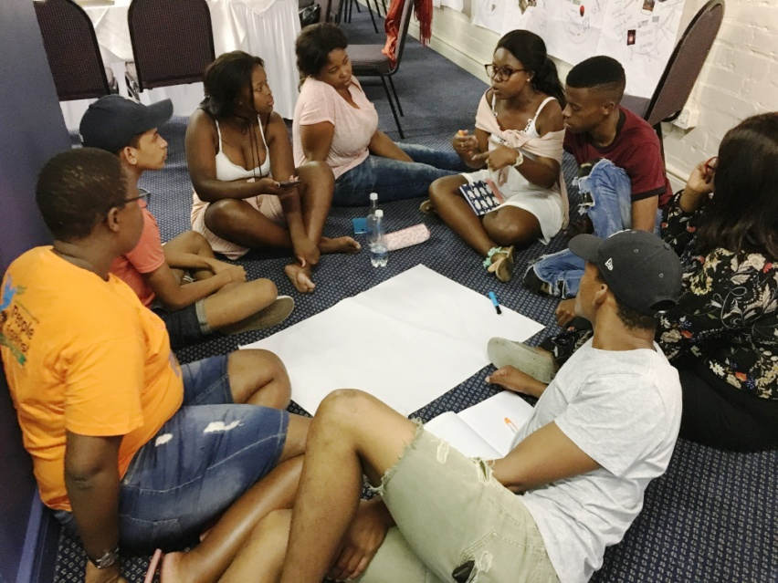
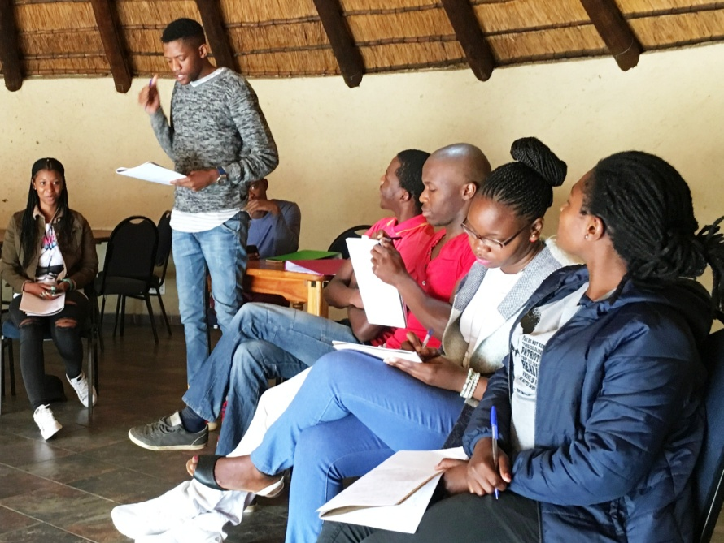
UMTAPO at universities

Slide 8
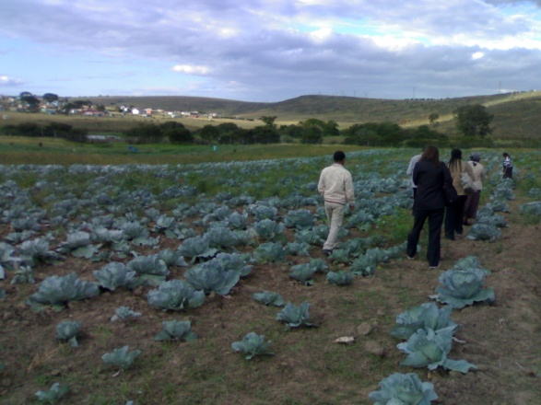
UMTAPO in the Community
Training of community activists especially unemployed youth
Promoting community self-help projects & cooperatives

Slide 9
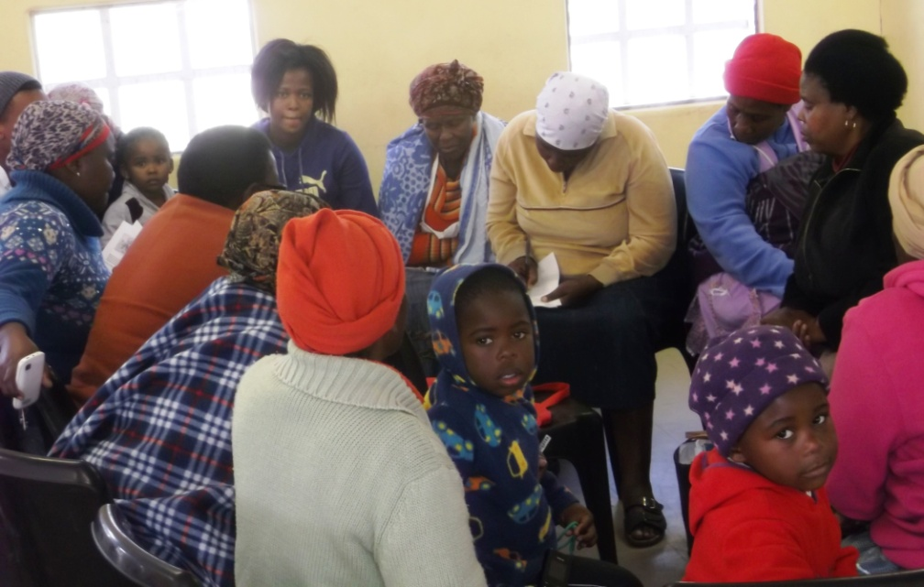
UMTAPO in the Community
Setting up Ubuntu Community Forums
Setting up Community Anti-Corruption Forums

Slide 10
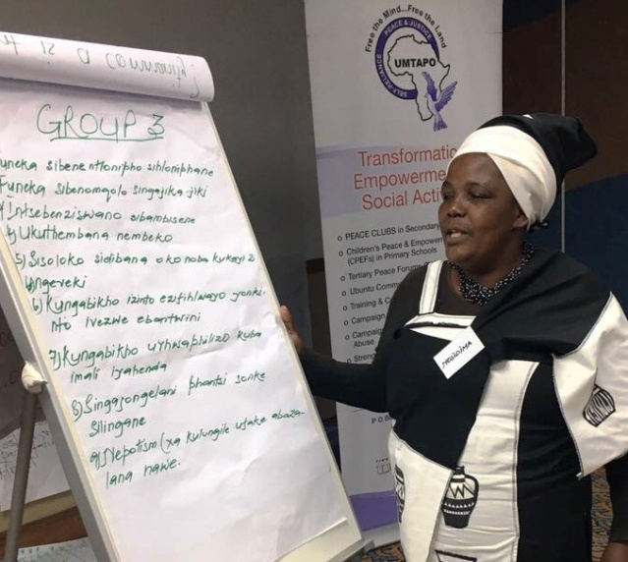
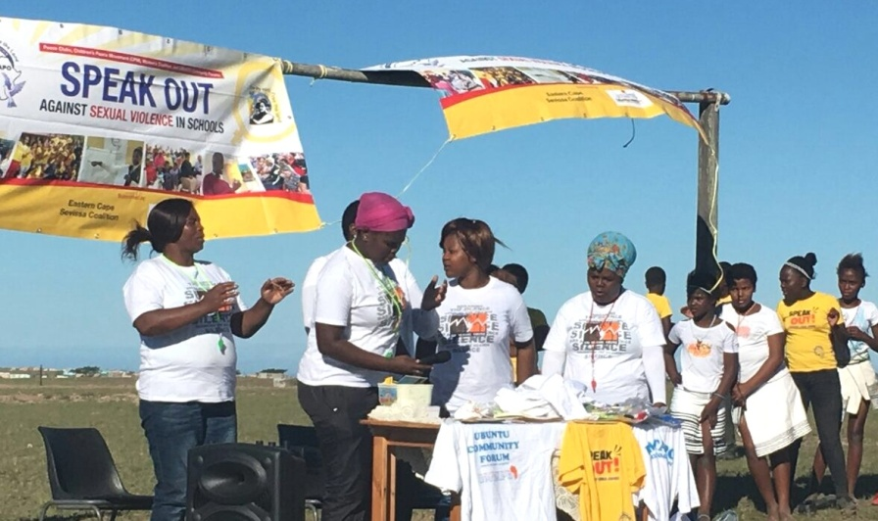
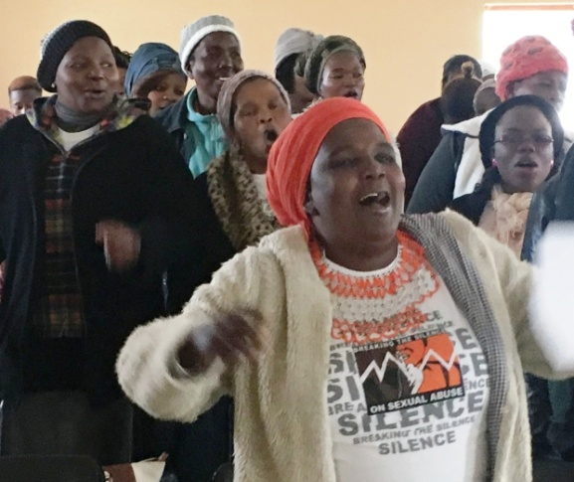
UMTAPO in the Community
Blow the Whistle Campaign in EC
International Anti-Corruption Day
Women’s Coalition and Ubuntu Community Forum Camps

Slide 11
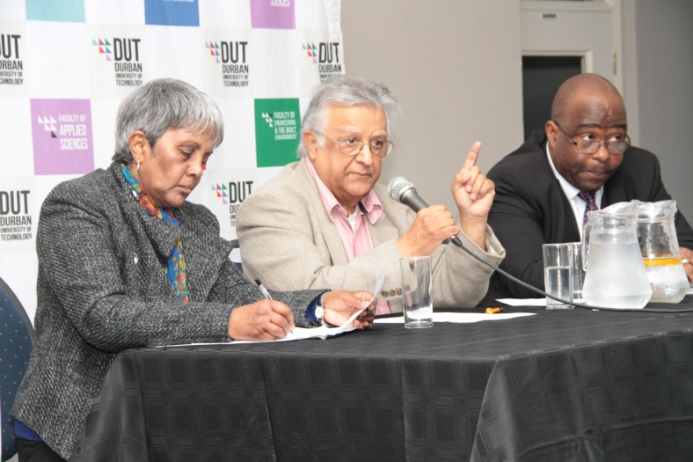
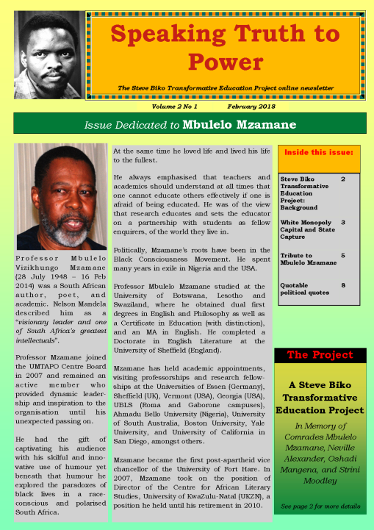
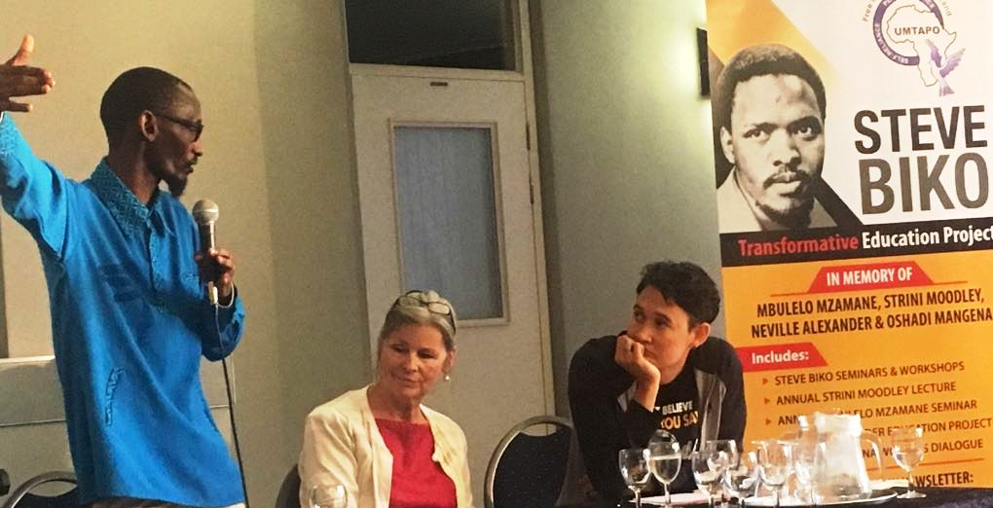
Special Projects/Events
Steve Biko Transformative Education Project
Online newsletter – Speaking Truth to Power
Seminars/workshops in partnership with tertiary institutions

Slide 12
International Partnerships
Umtapo
RADAR
Holland
University of
Nairobi/PUP
Kenya
Artillery Youth
N. Ireland
International Peace Bureau
Pan African Association for Literacy & Adult Education
Peace Child International

